Slide 1
JUnit Testing Framework
CS 441, Spring 2020, Yongjie Zheng

Slide 2
JUnit
An open-source software framework to write and run tests. JUnit features include:
  Assertions for testing expected results
  Annotations for identifying methods that specify a test
  Test runners for running tests
JUnit was written by Erich Gamma (of Design Patterns fame) and Kent Beck (creator of XP methodology)
Available as a stand-alone application and built into Eclipse.
  The current version of the Eclipse JDT has the JUnit plug-in built in.

Slide 3
Software Frameworks
A framework is a reusable, “semi-complete” application that can be specialized to produce customer applications.
A framework is a set of classes that embodies an abstract design for solutions to a family of related problems.
A framework is a set of cooperating classes, some of which may be abstract, that make up a reusable design for a specific class of software.
A framework is the skeleton of an application that can be customized by an application developer.

Slide 4
Inversion of Control
The framework code usually has the thread of control and calls the application code (i.e. inversion of control).
This is also known as the Hollywood principle: “Don’t call us - we call you”.
This is an important difference between software frameworks and normal libraries (which are usually called by the application code).
Image source: https://medium.com/datafire-io/libraries-vs-frameworks-626cdde799a7

Slide 5
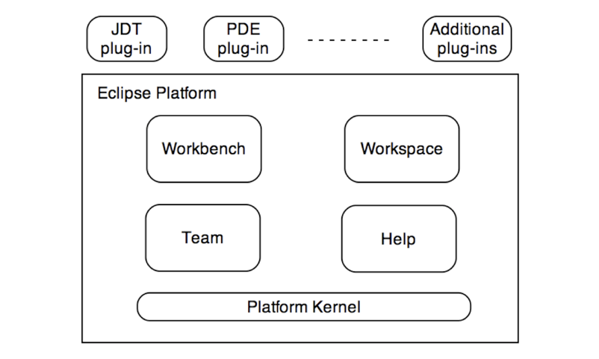
Eclipse Integrated Development Environment
Eclipse is a free, open, and extensible IDE that is widely used to develop applications in Java and other programming languages including C, C++, and Perl.
Eclipse is a small kernel (i.e., an implementation of the OSGI framework) surrounded by hundreds (and potentially thousands) of plug-ins.

Slide 6
About Eclipse
Developed by the Object Technology International (OTI) group of IBM.
Based on VisualAge Java that was written in Smalltalk.
Eclipse is written in Java.
First released in 2001.
The Eclipse foundation was created in 2004.
Eclipse 3.0 was released in 2004. This was the first version of Eclipse based the OSGi framework.
Currently, a new version is released annually.

Slide 7
Download and Installation
Eclipse does not include the Java Runtime Environment (JRE) and Java Development Kit (JDK)
  To check if JRE is installed on your machine, run: java - version
  JDK (which includes JRE) can be downloaded from http://www.oracle.com/technetwork/java/javase/ downloads/index.html
Getting Eclipse
  http://www.eclipse.org/downloads/
  Please download and install Eclipse IDE for Java Developers.

Slide 8
Write a Test Class with JUnit
public class Hello{
public String say(){
return “Hello”;
}
public String echo(String s){
if (s == null){
throw new Exception();
}
return s;
}
}
public class HelloTest {
private Hello h;
@Before
public void setUp() {
h = new Hello();
}
@After
public void tearDown() {}
@Test
public void testSay() {
assertEquals(“Hello”, h.say());
}
}

Slide 9
Steps to write a test case with JUnit
Define a Test class.
Optionally override the methods annotated with @before, @after to create or release object(s) under test.
Define one or more public testXXX() methods (annotated with @Test). Within each method,
  Call the method being tested and get the actual result
  Assert what the correct result should be with one of the provided assert methods
  These steps can be repeated as many times as necessary
Test methods are independent of each other, and a new instance of the test class is created for every test method.

Slide 10
JUnit Annotations
Annotation | Description
@Test public void method() | The annotation @Test identifies that a method is a test method.
@Before public void method() | Executes the method before EACH test. This method sets up the test data.
@After public void method() | Executes the method after EACH test. This method can cleanup the test data.
@BeforeClass public static void method() | Executes the method once, before the start of ALL tests.
@AfterClass public static void method() | Executes the method once, after ALL tests have have been finished.
@Ignore | Ignores the test method.
@Test (expected = Exception.class) | Fails, if the method does not throw the named exception.
@Test(timeout=100) | Fails, if the method takes too long.

Slide 11
Test Fixtures
A test fixture is the data (both objects and primitives) that are needed to run tests
  JUnit supports sharing the setup code
public void setUp() (annotated with @Before)
  Sets up the test data (fixture).
  Called before EVERY test case method.
public void tearDown() (annotated with @After)
  Tears down the test fixture.
  Called after EVERY test case method.
public static void setUpBeforeClass() (@BeforeClass)
public static void tearDownAfterClass() (@AfterClass)

Slide 12
JUnit Assert Methods
JUnit assert is a collection of static methods defined for checking actual values against expected values
We only used assertEquals in previous example, but there are additional assert methods
JUnit static import
  To use these assert methods without mentioning the class name, the static import statement is usually added at the beginning of each test class.
  import static org.junit.Assert.*;

Slide 13
JUnit Assert Methods
Method | Meaning
fail([String]) | Causes the test to fail.
assertEquals([String message], expected, actual) | Test if the values are the same.
assertNull([message], object) | Checks if the object is null.
assertNotNull([message], object) | Check if the object is not null.
assertSame([String], expected, actual) | Check if both variables refer to the same object.
assertNotSame([String], expected, actual) | Check that both variables refer not to the same object.
assertTrue([message], boolean condition) | Check if the boolean condition is true.
assertFalse([message], boolean condition) | Check if the boolean condition is false.

Slide 14
Testing Exceptions (two different ways)
@Test
public void testEcho(){
try {
h.echo(null);
fail(“should raise an exception”);
} catch (Exception e){
//expected
}
}
@Test(expected = Exception.class)
public void testEcho(){
h.echo();
}

Slide 15
Test Suite
Test Suite is a composite of Tests, or a combination of test classes.
  A suite usually contains a set of test classes, but a suite can contain another suite and so on.
Most IDEs create suites for you. If you have to create suites yourself:
import org.junit.runner.RunWith;
import org.junit.runners.Suite;
import org.junit.runners.Suite.SuiteClasses;
@RunWith(Suite.class)
@SuiteClasses({ MyClassTest.class, MySecondClassTest.class })
public class AllTests {
}

Slide 16
Test Runner
Running a TestSuite will automatically run all of its subordinate Test class instances and TestSuite instances.
Running a Test class will automatically invoke all of its annotated @Test methods. In other words, one Test class could result in multiple tests.
  All test methods can be executed in an arbitrary order.
For each @Test method
  Run @Before method if defined
  Run @Test method steps
  Run @After method if defined

Slide 17
Integration Tests With JUnit
JUnit is primarily used for unit test.
There is no clear line between unit test and integration test.
  A specific method may involve the integration logic.
Two ways to do integration tests with JUnit
  Do unit test, as previously discussed, on a method that includes the logic of calling other objects.
  Define a testXXX() method that tests a specific transaction, instead of a method. In this testXXX(), call related objects to check if the transaction is implemented correctly.

Slide 18
Note that
Additional information
  JUnit Pocket Guide (Search “JUnit” at http://proquest.safaribooksonline.com)
  JUnit 4 vs JUnit 5
    https://stackabuse.com/unit-testing-in-java-with-junit-5/
  JUnit Tutorial http://www.vogella.com/articles/JUnit/article.html

